Slide 1
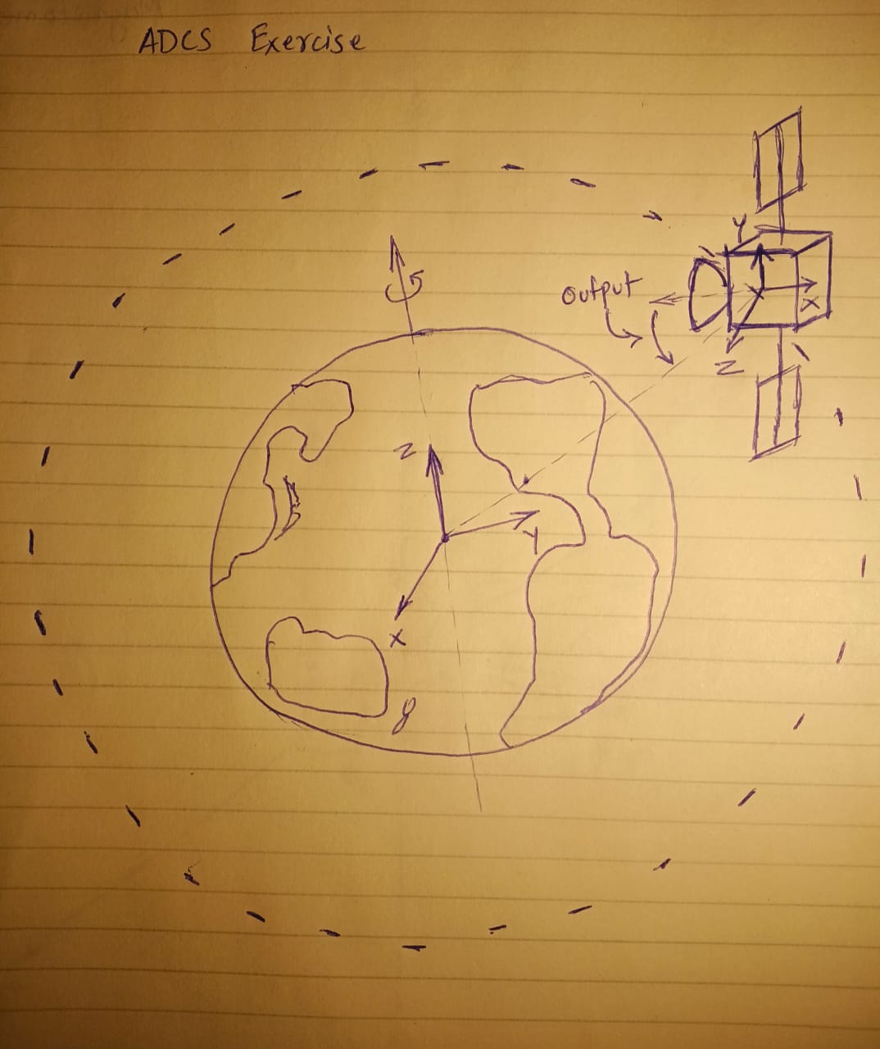
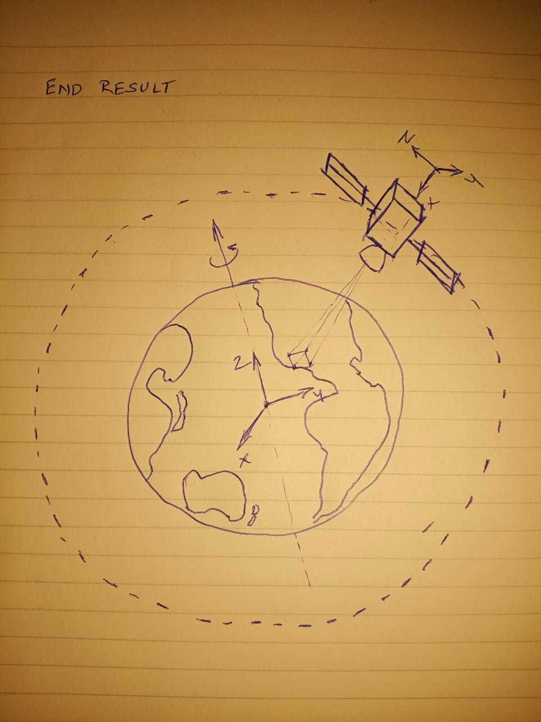
Problem Statement
Based on a given pair of latitude and longitude by the user, align the camera axis of the satellite (X-axis of satellite body frame) towards the point on the Earth defined by the input latitude-longitude pair.
Expected output
The rotation sequence to point the camera towards a specific point on the Earth.
Assumptions
1. The initial orientation of the satellite in LEO is random.
Future scope / In process
Add logic for continuous attitude measurement and adjustments to account for perturbations.
Add logic to factor in data from attitude measurement sensors like star trackers and IMUs to determine the specific attitude of the satellite at any point in orbit.
A
B
Y
Z
Pacific Palisades
Pacific Palisades
e.g. Point the X-axis of the satellite towards the Pacific Palisades located in the state of California in the US. Co-ordinates for the target location are 34.0467° N, 118.5464° W (Latitude 34.0467; Longitude -118.5464)

Slide 2
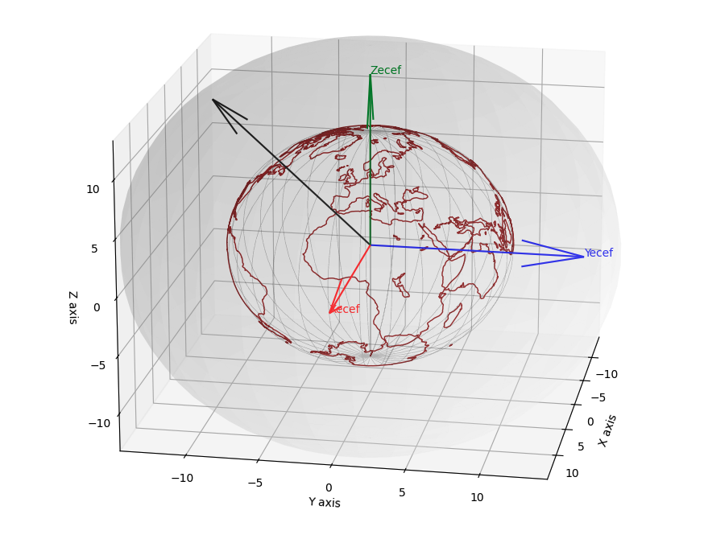
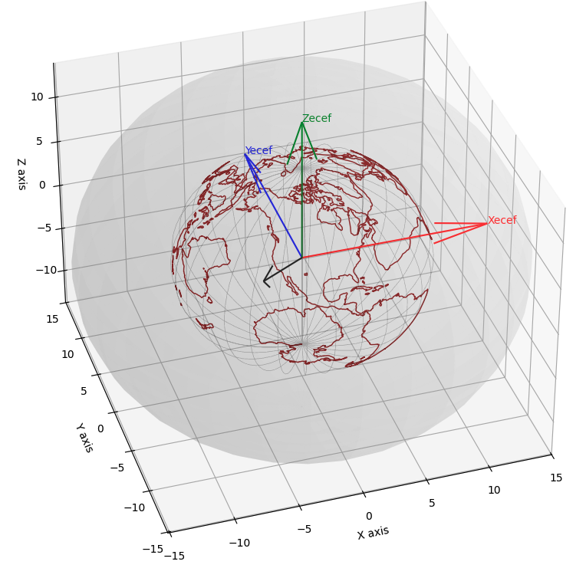
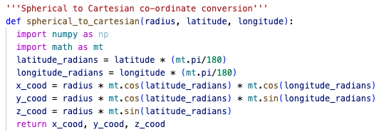
Earth Model with ECEF reference frame and a vector pointing towards the target
The purpose of this step is to determine the point in LEO where the origin of the satellite body-reference frame needs to be.
The vector is plotted by using the cartesian co-ordinates derived from the following parameters:
Length = radius of LEO; Azimuthal angle = Longitude; Elevation = Latitude (Python function on the right)

Slide 3
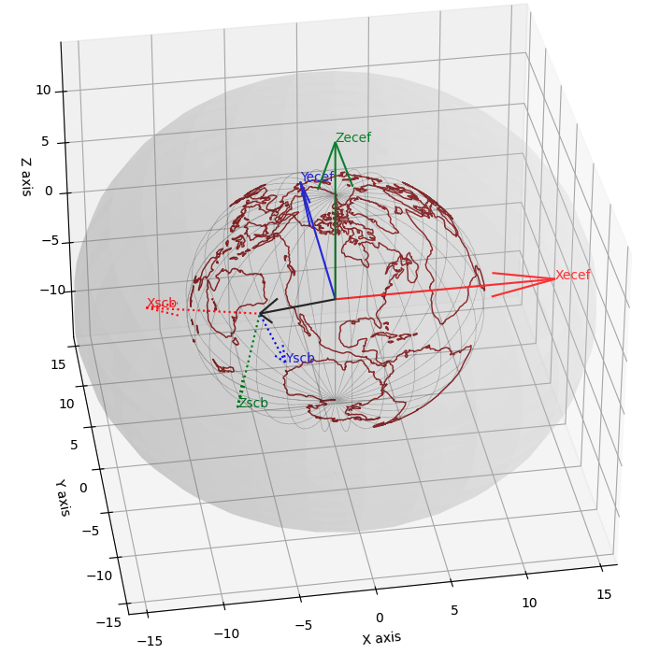
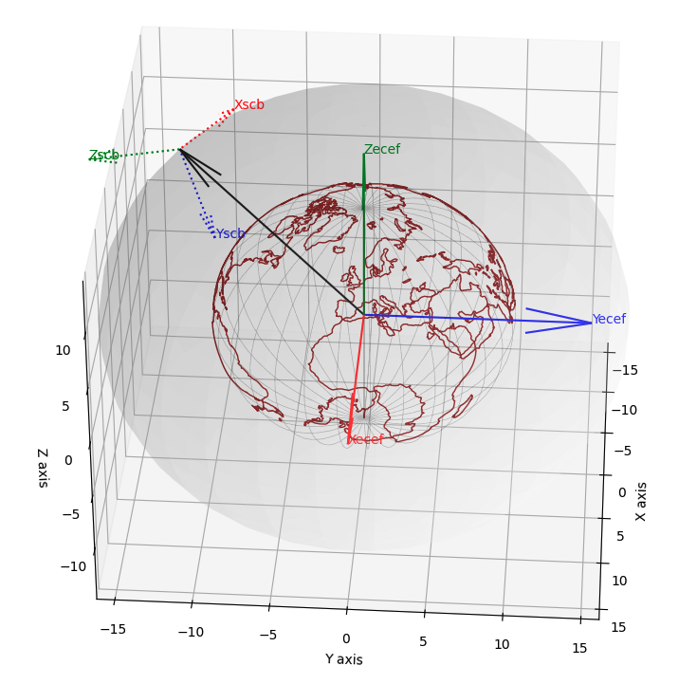
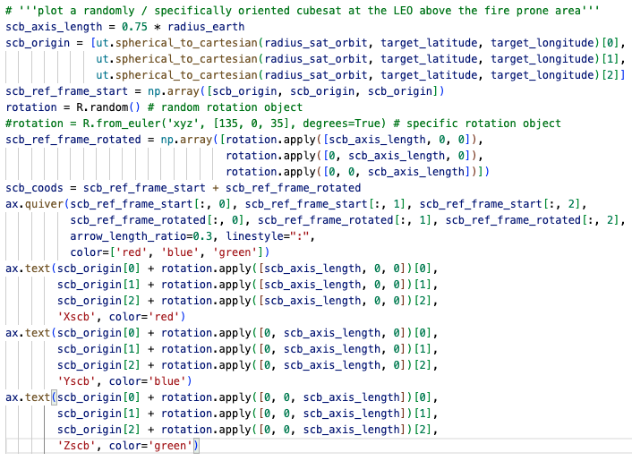
Randomly oriented satellite body frame at the specific LEO point as origin
View 1
View 2
The purpose of this step is to visualize a randomly oriented satellite in LEO. SCB stands for Spacecraft Body.
The decision to choose a random orientation is made because we need the algorithm to work on the entire space of possible satellite orientations.
The option to apply specific rotations is commented out but can be used to test out user-specified rotation sequences.
Note: The ‘from_euler’ function is available in Python for directly applying a rotation sequence but not used since we are building the logic for Euler angle calculations from scratch.

Slide 4
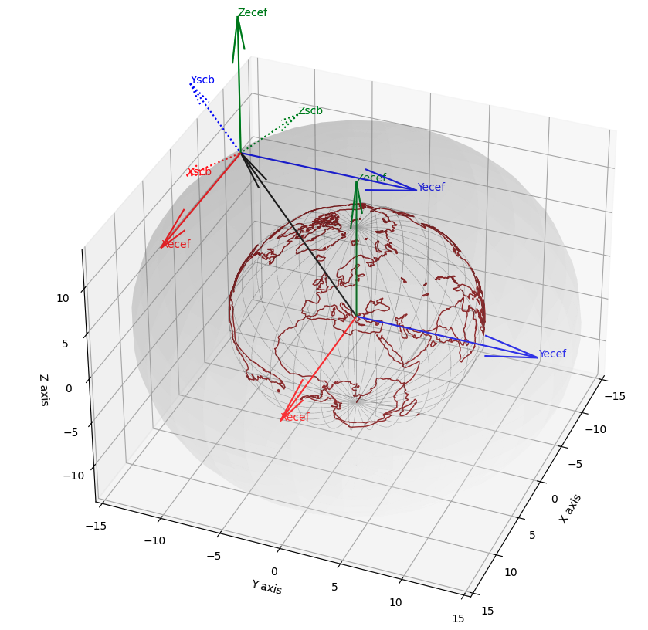
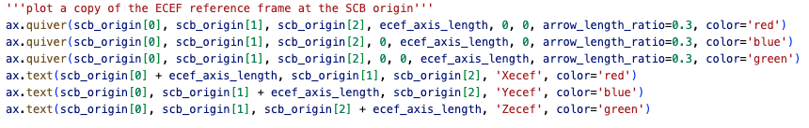
A copy of the ECEF reference frame at SCB origin in LEO
To determine the rotation sequence for the SCB reference frame, I followed the approach of first measuring its orientation with respect to the ECEF reference frame.
The purpose for this alignment is that when the SCB reference frame aligns with the ECEF reference frame, the problem is then reduced to aligning rotations to SCB that are a function of the latitude and longitude data available to us.

Slide 5
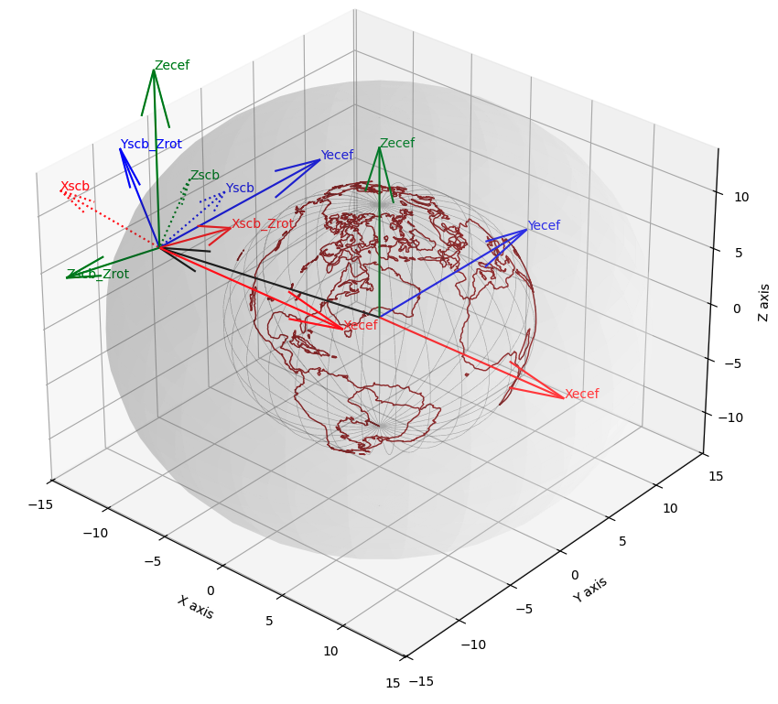
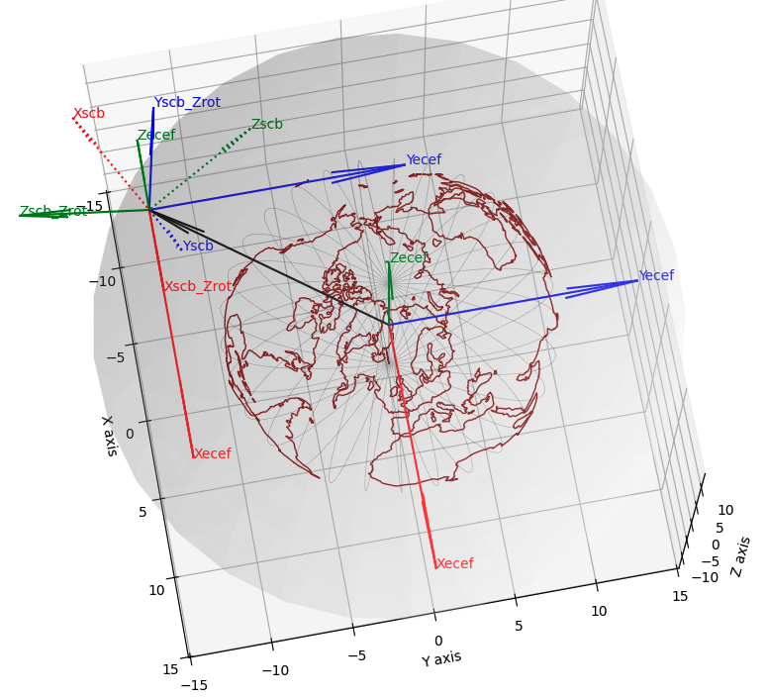
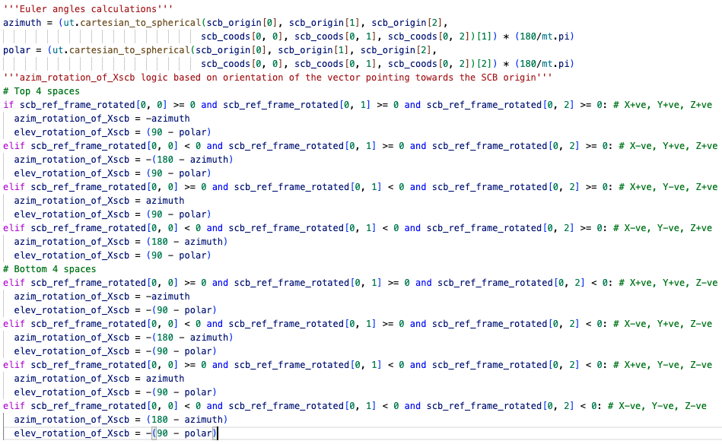
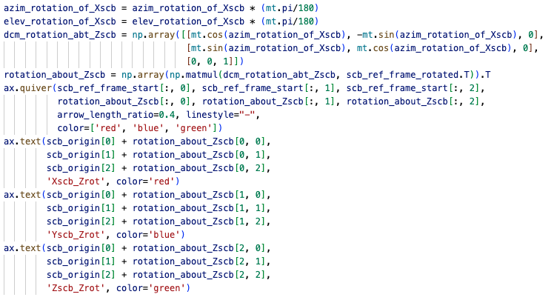
Step 1: Rotate about Zecef axis by the azimuthal angle of Xscb
View 1
View 2
Here we rotate the SCB reference frame about Zecef by the azimuthal angle of the Xscb axis. This is the first step towards aligning SCB with ECEF.
The rotation angle (‘azim_rotation_of_Xscb’ in the code) depends on where the satellite is located in the available 8 spaces. This is handled by the if…elif loop in the code.
The original reference frame is denoted by ‘…’, and the rotated reference frame is denoted by solid line with labels ‘…_Zrot’. e.g. Here we rotated Xscb by ~146 degrees to get to Xscb_Zrot

Slide 6
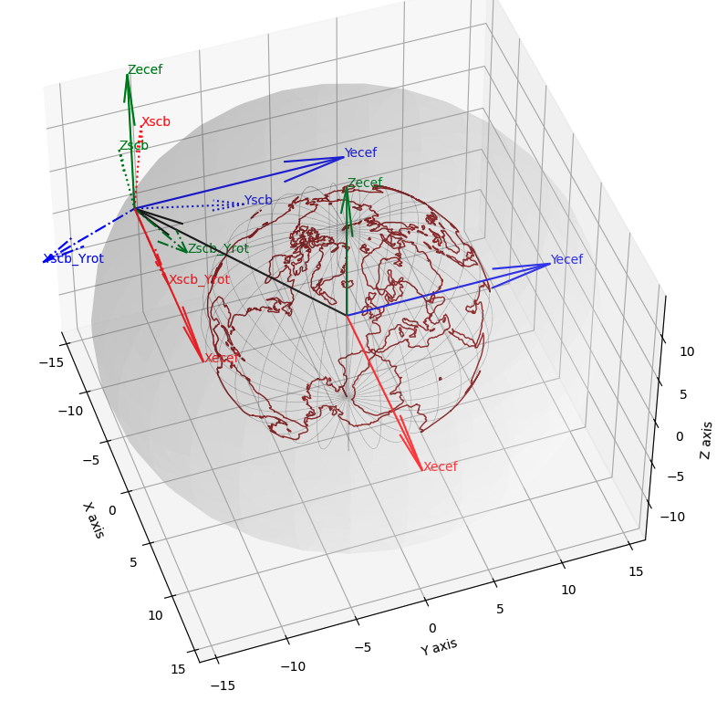
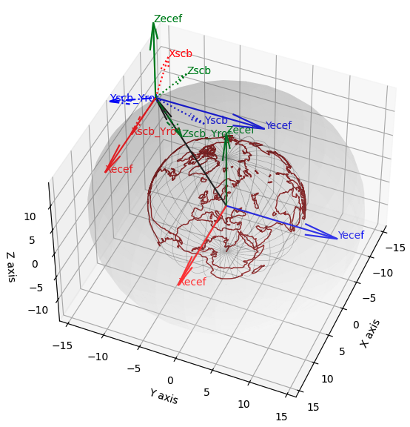
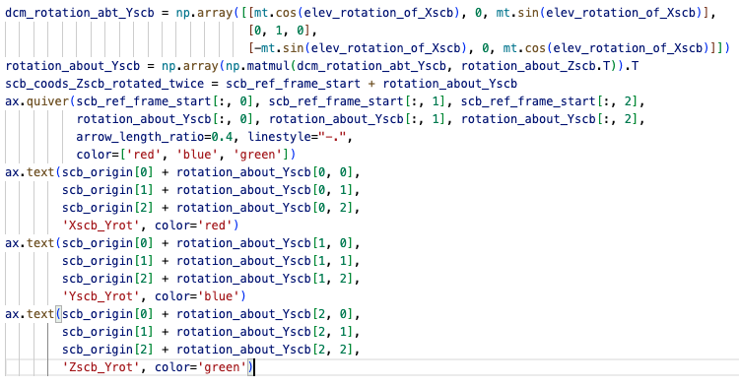
Step 2: Rotate about Yecef axis by the elevation angle of Xscb
View 1
View 2
Here we rotate the SCB reference frame about Yecef by the elevation angle of the Xscb axis. This is the second step towards aligning SCB with ECEF. The direction cosine matrix is defined by the ‘dcm_rotation_abt_Yscb’ variable.
The rotation angle (‘elev_rotation_of_Xscb’ in the code) is the elevation angle of Xscb. By rotating Xscb by this angle we are now placing it in the Xyecef plane. This with the 1st rotation aligns Xscb with Xecef.
The original reference frame is denoted by ‘…’, and the rotated reference frame is denoted by ‘-.-.-’ with labels ‘…_Yrot’. e.g. Here we rotated Xscb by ~74 degrees to get to Xscb_Yrot. (Note: this is a different example from the previous slide as code needs to be executed multiple times for screenshots, each run starts with a randomly oriented SCB. RefFrame_Zrot is not shown to avoid congestion.)

Slide 7
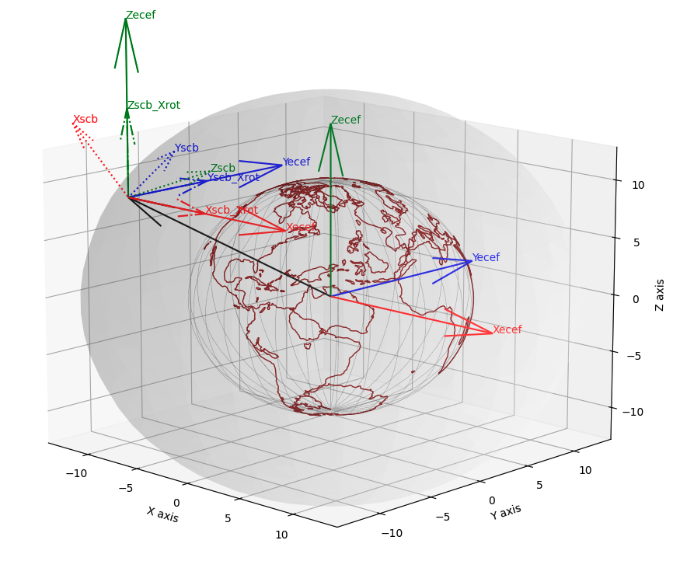
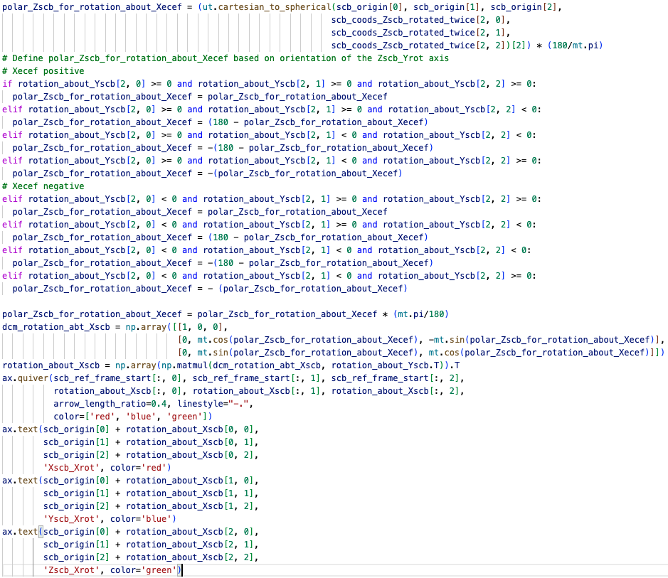
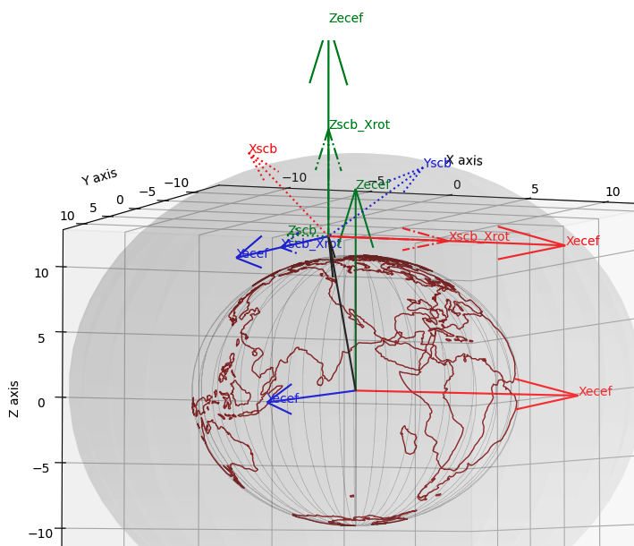
Step 3: Rotate about Xecef axis by the angle between Zscb_Yrot with Zecef
View 1
View 2
Here

Slide 8
Steps in the project
Purpose of the CubeSat Mission
Purpose of the ADCS subsystem
Design steps involved in designing the ADCS
Design of the ADCS algorithm
Autonomous capabilities for ADCS
Testing of Hardware, Simulation testing, Monte Carlo, Hardware in the loop

Slide 9
Project Steps
Problem
Proposed Solution
Testing / Charts for error metrics
Solution Implementation

Slide 10
Explanation of the Python code

Slide 11
Why are maneuvers performed
Types of maneuvers
Maintaining Orbit and Altitude – to keep the satellite at a desired altitude and speed, ensuring consistent data collection.
Maintaining a consistent ground track – For polar-orbiting satellites like Landsat, these maneuvers keep the satellite’s ground track and timing of its equatorial crossings consistent over time.
Counteracting Orbital Perturbations - The gravitational forces of the Sun and Moon, along with factors like solar radiation pressure and the weak effects of Earth’s non-uniform gravity, can alter a satellite’s orbit, requiring adjustments to stay on course.
Drag make-up (DMU) or Delta-Velocity (Delta-V) maneuvers – To increase the satellites orbital velocity to raise its altitude, counteracting the effects of atmospheric drag that would otherwise lower the orbit time.
Inclination Adjustment (IAM) or Delta-Inclination (Delta-I) maneuvers – These burns are performed to adjust the angle of orbit relative to the Earth’s equator, which is necessary for maintaining a consistent ground track for land-observing satellites and for managing the change in inclination caused by gravitational forces from the Sun and Moon.
Station-Keeping maneuvers – These are small adjustments to the satellite's orbit and position to counteract gradual orbital perturbations caused by the gravitational pull of the Moon and the Sun.
Longitudinal Shift Maneuvers – These maneuvers change the satellite’s sub-satellite point on the Earth’s equator, often by adjusting the satellite’s orbital period to match the Earth’s rotation for geostationary or geosynchronous orbits.

Slide 12
Problem
Proposed solution
Build an algorithm to point the satellite camera towards a location provided by the user.
1. Depending on the latitude-longitude data provided by the user, create the sequence of maneuvers required to:
Move the satellite from its current location in the xyz orbit directly above the location of interest. i.e. trajectory determination, optimum thrust calculation based on rotation of the Earth.
Once directly above the location of interest, attitude estimation & Euler rotation sequence calculation to point the camera directly towards the location of interest. (demonstrate usage of sensor data)
Euler sequence to maintain the attitude required to keep the antennas pointed towards the ground station.
Thrust calculations to account for perturbations due to gravity created by the moon and the sun. (implementation of methods used to mitigate attitude deltas due to various perturbations)
2. Animation of the algorithm steps.

Slide 13
Design of the ADCS algorithm
Performance of the algorithm

Slide 14
Autonomous capabilities for ADCS
RL for G & C

Slide 15
Autonomous capabilities for ADCS
NN for State Estimation

Slide 16
Recap

Slide 17
Questions, Comments, Feedback

